Slide 1
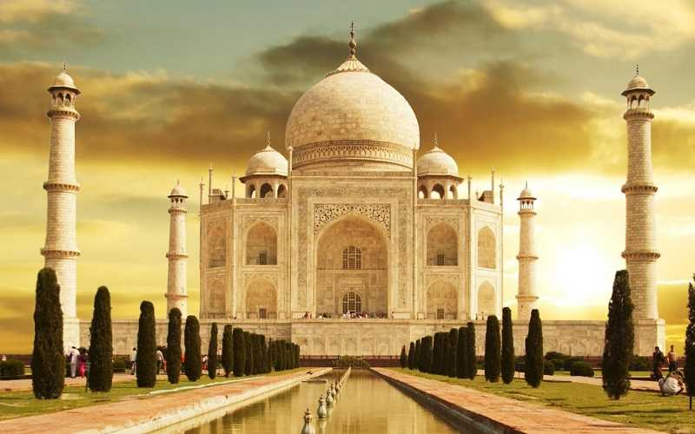
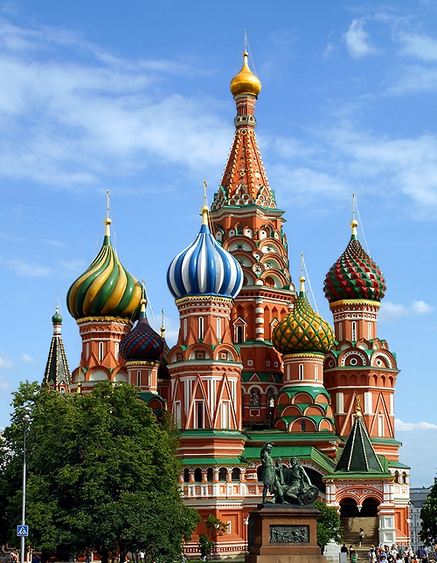
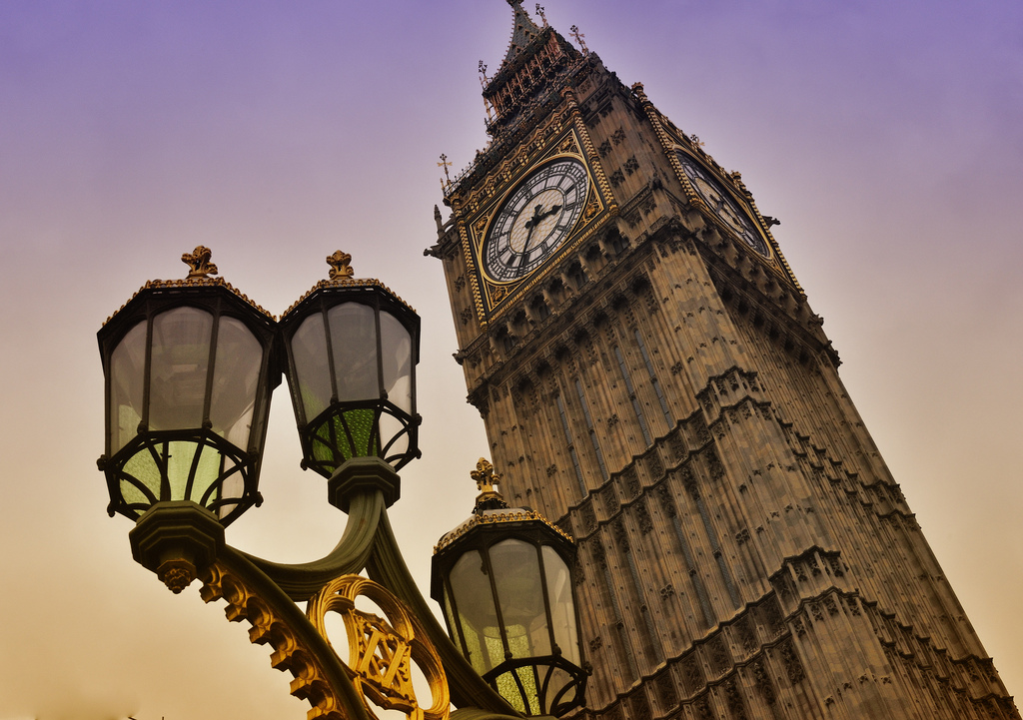
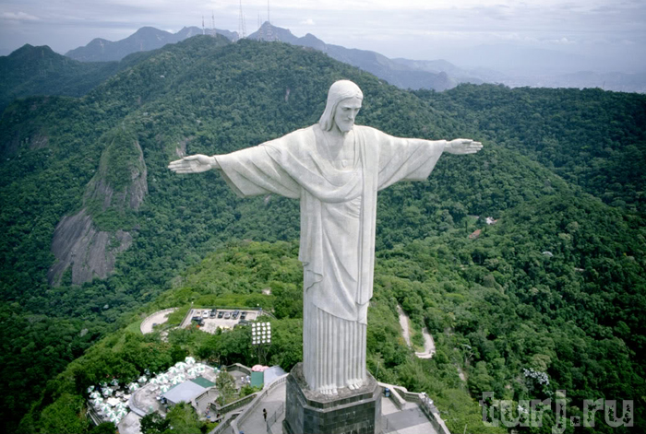

Slide 2
Man – made Wonders

Slide 3
Answer the questions:
What is Stonehenge famous for?
When was Stonehenge built?
Who built Stonehenge?
Why did ancient people build Stonehenge?
What is Stonehenge now?
Would you like to see this great monument? Why?

Slide 4
Thank you for the lesson

